Slide 1
Azure Verified Modules (AVM) The Microsoft IaC Module Strategy for Bicep & Terraform

Slide 2
Problem Statement from our Customers
Customer operates cloud with ClickOps
Customer starts adopting basic IaC and DevOps practices
Proliferation of code, lots of repeated lines
Customer tries to decouple repeated code & rationalize
Customer looks for open-source IaC repos
There are many IaC repos with their own standards
Customer picks one repo
The repo is not officially supported by Microsoft, or the repo gets abandoned over time
Solution: introduce the official Microsoft approach, Azure Verified Modules (AVM)

Slide 3



What is our mission?
“Our mission is to deliver a comprehensive Azure Verified Modules library in multiple IaC languages, following the principles of the well-architected framework, serving as the trusted Microsoft source of truth.
Supported by Microsoft, AVM will standardize and accelerate the deployment of Azure resources and architectural patterns, empowering every person and organization on the planet on their IaC journey.”
1
a
3
e
c
o
e
p
h
2
r
s
f
Provide common IP for our Customers, Partners and Microsoft
v
g
k
t
u
l
4
x
j
w
n
y
m
bb
aa
cc
dd

Slide 4










Azure Verified Modules (https://aka.ms/AVM)
AVM is a community driven initiative to consolidate and set the standards for Infrastructure-as-Code modules.
AVM modules are composable building blocks that encapsulate groups of resources dedicated to one task. These modules are used to deploy Azure resources and their extensions consistently.
AVM accelerates the delivery of cloud-native or migrated applications and their supporting infrastructure, reliably/consistently and at scale, by codifying Microsoft guidance (WAF), with best practice configurations (Resiliency and Security by default).
Azure Verified Modules
PAR
Variant 1: Plain storage account, sku1, kind1
Pattern 1 (AKS LZA)
Pattern 2 (AVD LZA)
Pattern N…
PAR
Variant 2: Plain storage account, sku1, kind2
PAR
Variant 3: Azure file shares, table
Resource Modules
PAR
Variant 4: Locked storage
PAR
Variant 5: Azure files share & RBAC
Domain Specific Languages
(Bicep, Terraform, etc.)
Flexible, generalized, multi-purpose
Integrates child resources
Integrates extension resources
Azure Resource Manager

Slide 5
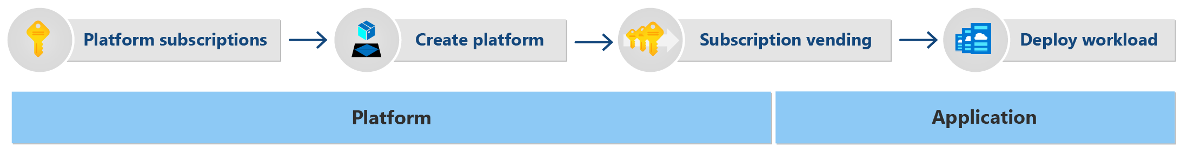
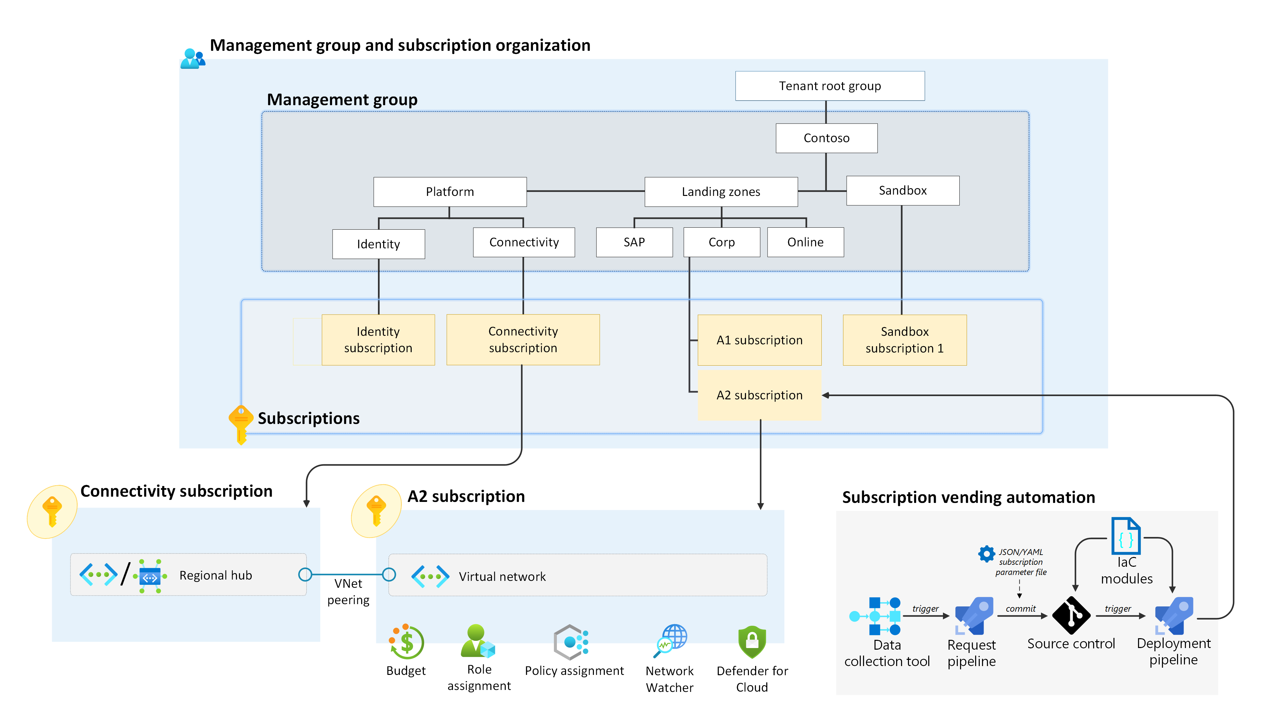
Where does AVM fit in our customer journey?
AVM is targeted towards customers wishing to build, construct and deploy workloads into their application landing zones (subscriptions). Whether self-constructed from resource modules or using pre-built pattern modules
These customers have typically already deployed ALZ using our existing implementation options

Slide 6
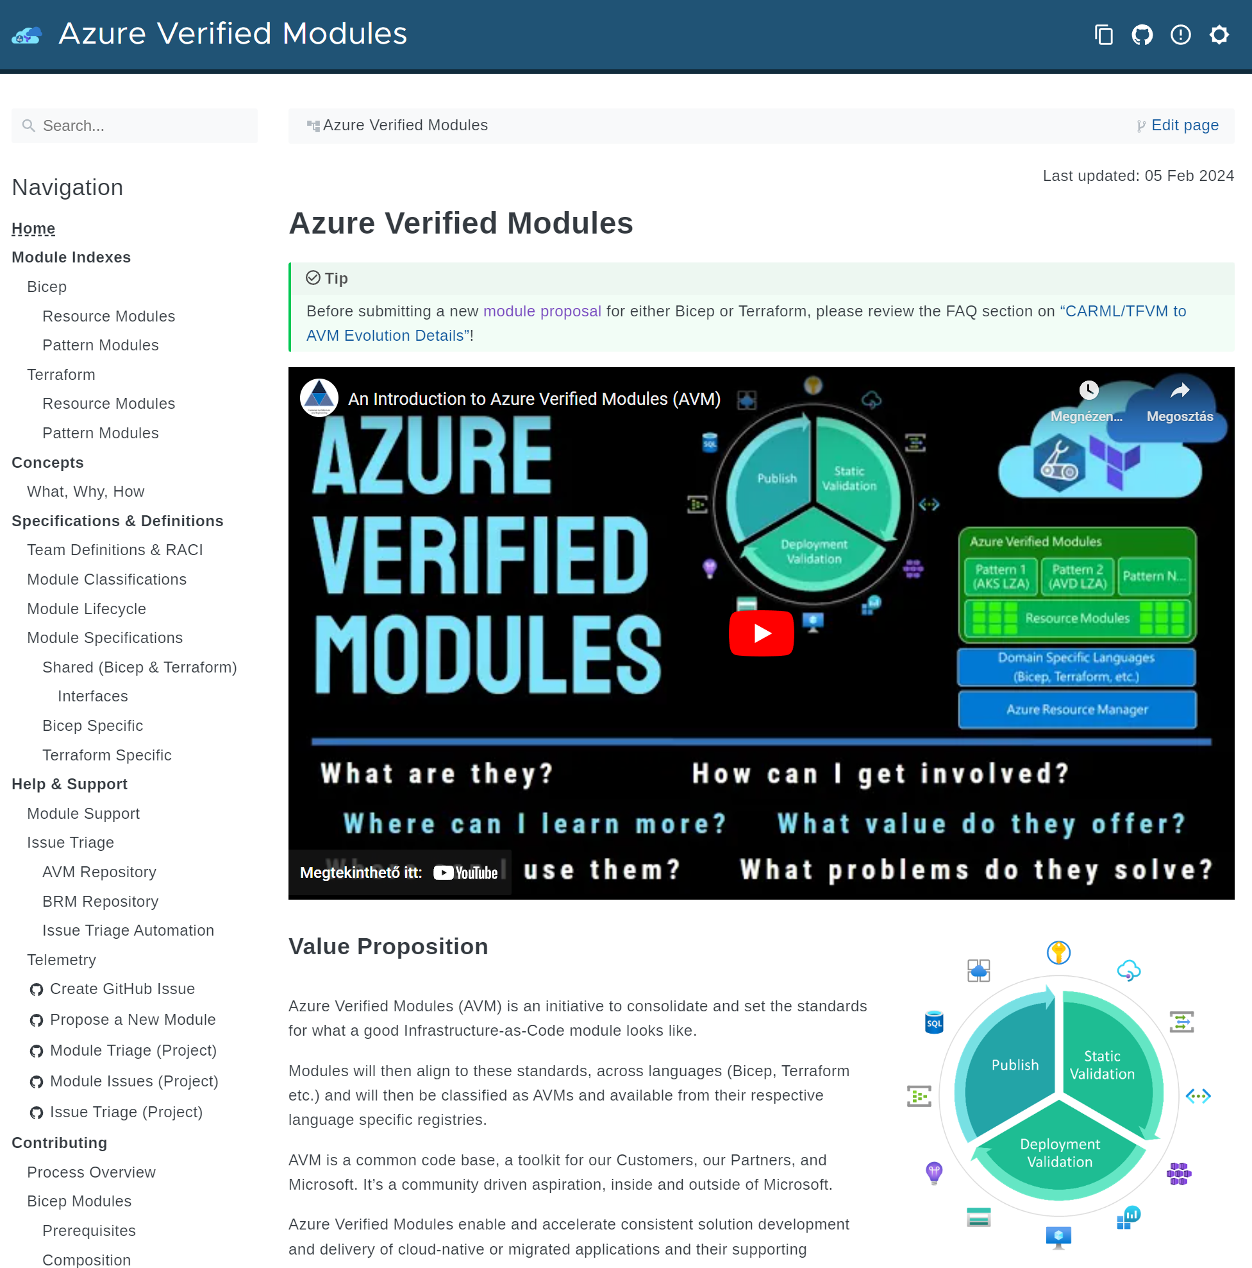
Website
aka.ms/AVM

Slide 7
Learn about AVM
Module indexes https://aka.ms/AVM/ModuleIndex
What does “Verified” mean? https://aka.ms/AVM/Verified
Telemetry https://aka.ms/AVM/Telemetry
FAQ
https://aka.ms/AVM/FAQ
Using AVM https://aka.ms/AVM/Using
Contributing https://aka.ms/AVM/Contributing
Module classifications https://aka.ms/AVM/ModuleClassifications
Module Support https://aka.ms/AVM/Support

Slide 8
Resources
✅Introducing Azure Verified Modules
Azure Verified Modules public website - https://aka.ms/AVM
Into video: https://aka.ms/AVM/intro
Intro blog: https://aka.ms/AVM/intro/blog
FAQ: https://aka.ms/AVM/FAQ
Module Index: https://aka.ms/AVM/ModuleIndex
Propose a new module: https://aka.ms/AVM/ModuleProposal
🧪Try out AVM using our labs:
Bicep lab: https://aka.ms/avm/bicep/labs
Terraform lab: https://aka.ms/avm/tf/labs
🧬Lifecycle and getting help/support
Request new feature/report bug for existing module
Bicep: https://aka.ms/AVM/Bicep/ModuleIssue
Terraform: create an issue on the repo of the module in question
Generic question for AVM: https://aka.ms/AVM/QuestionFeedback

Slide 9
Thank you!

